Slide 1


Learn-To-Code
Android App
Submitted By
Suchana Biswas Cheity
ID: 200212003010
Sormila Akter Tithy
ID: 20212015010
Jarin Anjum Tisha
ID: 200212019010
MD. Nahid Hasan
ID: 20212041010
Submitted To
Md. Mazharul Islam
Lecturer
Department of CSE
North Western University,
Khulna
Notes:
Good Afternoon everyone. Welcome to this presentation on our innovative learn to code app. An android platform that helps everyone to dive into the world of programming. Lets keep things simple and dive into what makes our app special.

Slide 2



To create a fun and easy way for people to learn Programming Languages.
OUR
OBJECTIVE
Pushing our boundaries in the field of software development.
Notes:
Our Goal was straightforward. We wanted to make learning programming fun and easy. We also wanted to test our limits in the field of software development by challenging ourselves with newer problems

Slide 3
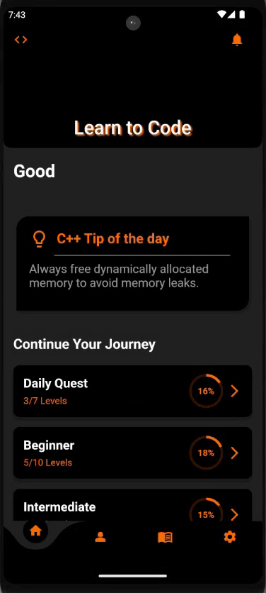

INTRODUCTION
A Code learning App: Android apps are the best ways to gamify a learning process. It’s perfect for students, beginners and enthusiasts.
Flutter, developed by Google, simplifies cross-platform app creation with a single codebase, emphasizing expressive UI design.
Notes:
Lets introduce our learning app. Learn to code: a handy tool for students, beginners or anyone interested to start the journey of programming. It runs on flutter, a cool framework from google that makes creating apps on android and ios both interactive and enjoyable.

Slide 4
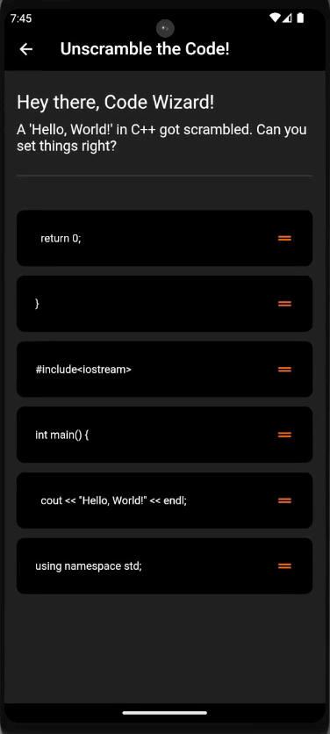

Application
MECHANICS
Gamified way to learn: Engage in a playful and interactive learning experience, making the journey fun and educational.
Backend development: Our app uses Firestore to manage and store all information securely .
Real time statistics: Users can see their real-time growth and adjust their learning accordingly.
Notes:
The core of our app is its mechanics. Learning becomes a game: an interactive adventure that blends fun and education seamlessly. Firestore, our backend wizard secures and manages information in real time while dynamic statistics keeps tab on the users growth.

Slide 5

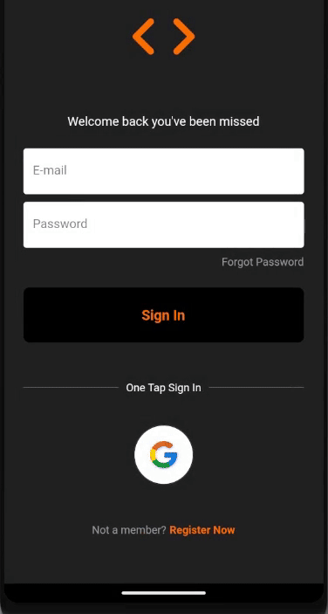
FEATURES
Animated UI
Enjoy a Visually appealing and animated UI for a better learning experience.
One tap sign in
Quickly and Securely sign in with google or create a new account easily.
Notes:
Now lets showcase the stars of the show. The features. Animated User interface always elevates the learning journey. Creating new accounts and Signing in is also very easy thanks to Google's one tap sign in.

Slide 6
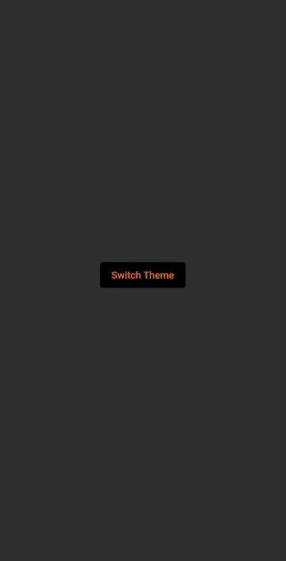
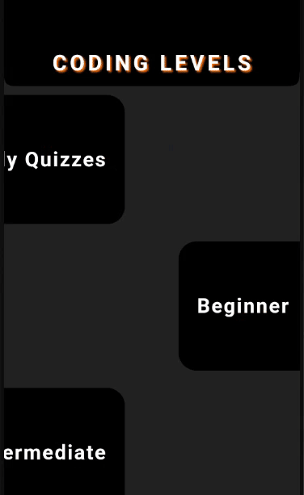
FEATURES
Different Levels
Easily move through different skill levels. So there is something for everyone
Profile and settings
Customize your profile and change different settings easily.
Notes:
User can also explore various stages based on their skill levels. So even if you are a pro at coding, our app will still have something to offer. Personalization is also a key. Customization of profiles and settings are effortless for users.

Slide 7
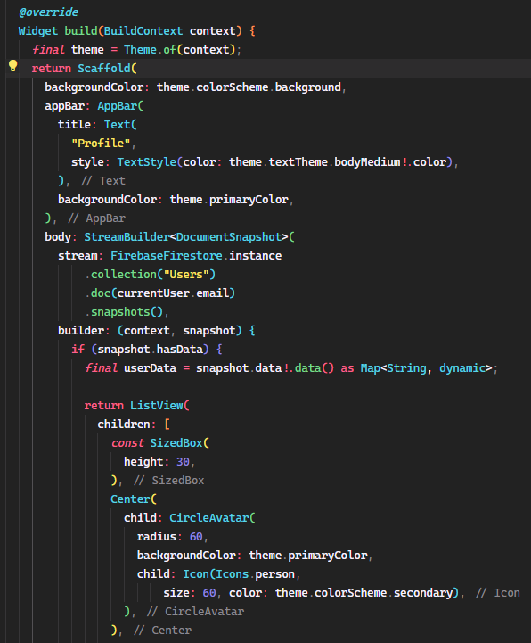

TECHNICAL
ASPECTS
Widgets: Widgets and dependencies are the main controlling unit of the app.
Flutter Framework: Flutter is used to ensure app works on different devices easily.
Firestore Integration: Firestore helps our app run smoothly and store information securely
UI/UX Design Consideration: It is designed to be easy to use and understand
Graphs and Wheels: Different graphs and table widgets are used to show statistics .
Smooth Animations: Implementing animations to create a dynamic learning environment.
Notes:
Now we get into the tech stuff. As we said before we used flutter framework to ensure our app runs smoothly across various devices. Firestore authentication and storage ensure security and reliability. We used various types of widgets. A LOT OF WIDGETS. And all of this was written in Dart: flutters own programming language.

Slide 8
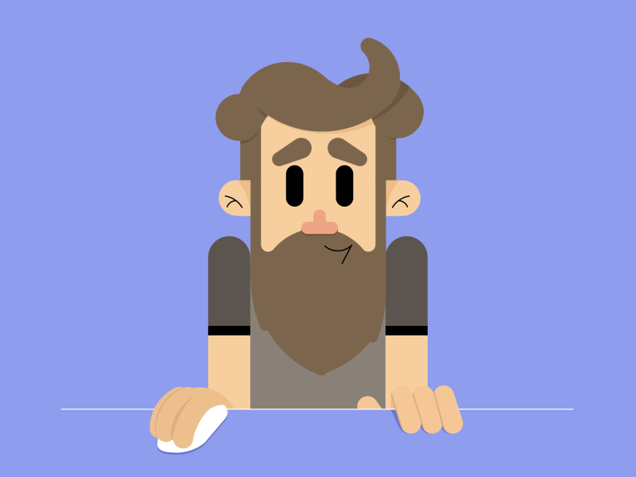

CHALLANGES
Animation Syncing: Ensuring animations align perfectly with other events and taps.
Graphs and Stats: As graphs are one of the newest edition to flutter; using it was quite challenging.
Balancing Act: Ensuring the User interface not get too much cluttered with widgets.
Data Security: Data and information handling securely through Firestore was quite a work too.
Notes:
Every Project comes with its own set of challenges. Syncing animations and balancing the amount of widgets are some of them. Using graphs in our app was also quite challenging as it is one of the newest edition to flutter. Data security was also our biggest concern.

Slide 9
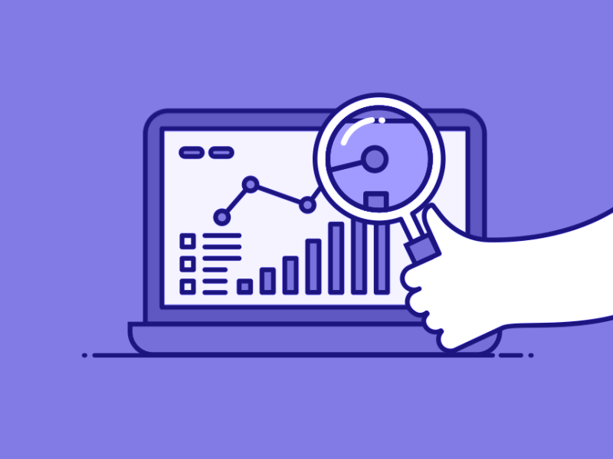
WHAT
WE LEARNED ?
Using Dart: Learning a new language by developing apps was quite an accomplishment.
Project management: Learned how to work together while handling larger projects.
Backend development: Handling and securing data through Firestore vastly increased our knowledge in backend.
Notes:
But Every challenge comes with learnings. We learned how to effectively collaborate on larger projects while also learning a new language. Getting the hang of managing and securing data was also a big accomplishment.

Slide 10

FUTURE
ENHANCEMENTS
More Language support: We want to add more languages other than C++ in the near future such as Python and Java.
Level Progression: A system where players can level up, unlocking new challenges and rewards.
Built in Compiler : An in-app compiler will help user to code real time in the app.
Better profiling: A better and interactive profile system will help users engage with other programmers.
Notes:
Looking ahead we have big plans for this project. We are thinking of adding more languages and also want to create a better levelling system. We also want to add an in-app compiler to code directly on our android platform.

Slide 11
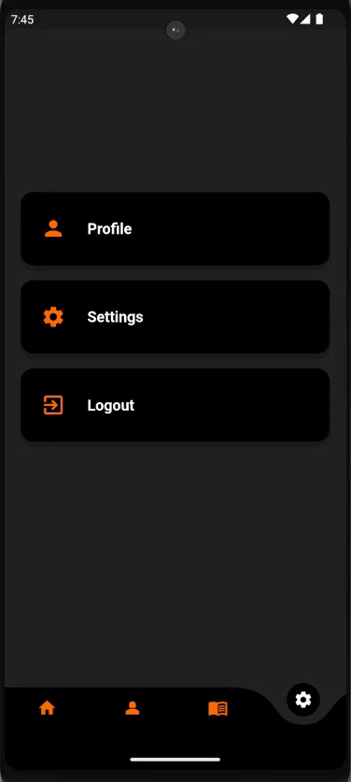
CONCLUSION
A Journey Beyond Code
"From idea to interface, we've transformed a vision into an interactive experience."
"This isn't just code—it's a collective triumph, each line bearing a story of collaboration."
“Learn-to-Code app will help many to advance their progression by making programming more fun "
Notes:
This project has been an incredible learning experience. By working together, we transformed a vision into a interactive learning experience. I would like to thank my team for all the efforts.

Slide 12
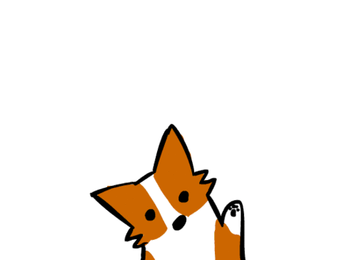
THANK YOU
"Thank you for your attention and interest in our project! We appreciate all the feedbacks that was given to us"
Notes:
We also appreciate all the feedbacks from everyone. Thank You

